Slide 1


School of Computing Science and Engineering
Course Code : BCS01T1001 Course Name: Data Analytics (Excel and Tableu)
Unit – 2
Manipulation of Excel Data
Faculty Name: Mr. Soumalya Ghosh Program Name: B.Tech CSE

Slide 2
Objectives
Filtering and sorting in Excel

Slide 3

Software process and Process Models
Data Filtering
Filtering data is referred to displaying only the set of data which meet certain condition.
Other data which are not meet the condition should be be gets hide
We can perform this operation using MS Excel
3

Slide 4
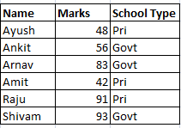
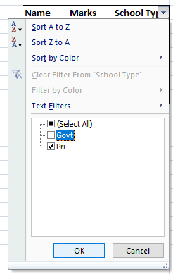

Software process and Process Models
Data Filtering: MS Excel
Steps
Click any single cell inside a data set.
On the Data tab, in the Sort & Filter group, click Filter.
4

Slide 5
Software process and Process Models
Sorting : MS Excel
Sorting
It is the process of arranging data in a ascending or descending order
Select Marks column in the data set
Select the Sort & Filter option
Click sort smallest to largest
5

Slide 6
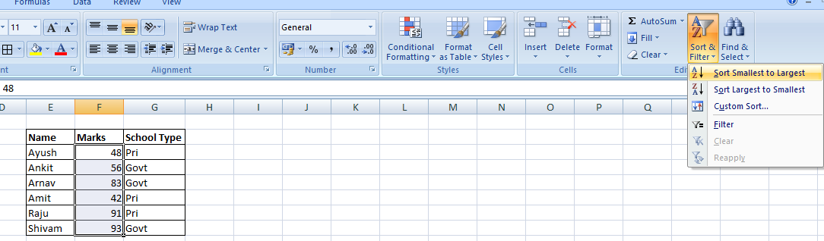
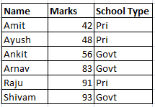
Software process and Process Models
Sorting : MS Excel
Sort on one column
6

Slide 7
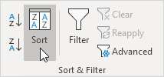
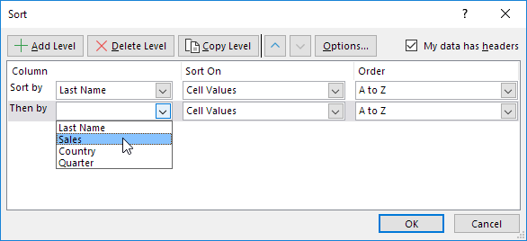
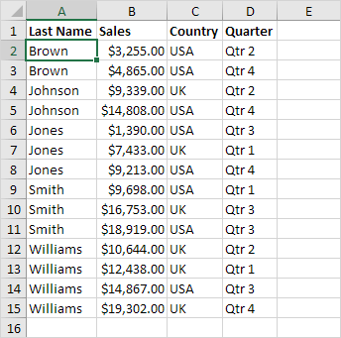
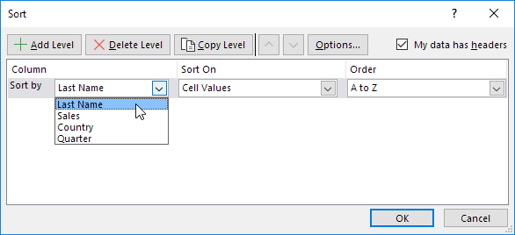
Sort on multiple columns
Basic Data Manipulation (Sorting)
On the Data tab, in the Sort & Filter group, click Sort.
Sorting dialog box appears
Select Last Name from the 'Sort by' drop-down list.
4. Click on Add Level.
5. Select Sales from the 'Then by' drop-down list.
6. Click OK

Slide 8
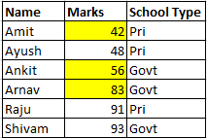
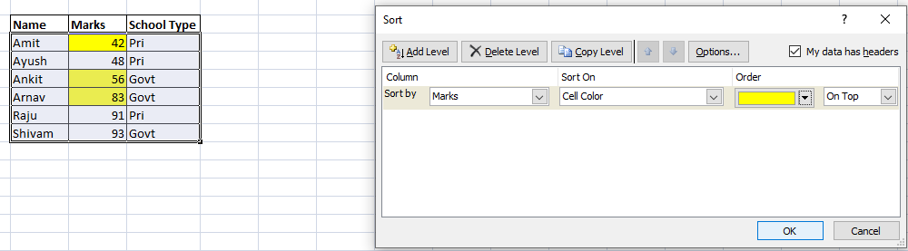
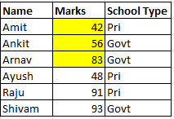
Software process and Process Models
Custom Sorting : MS Excel
8

Slide 9
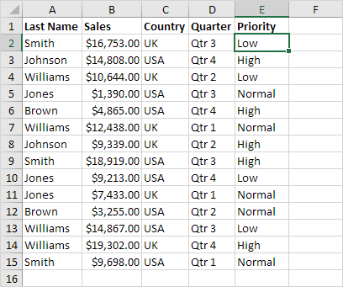
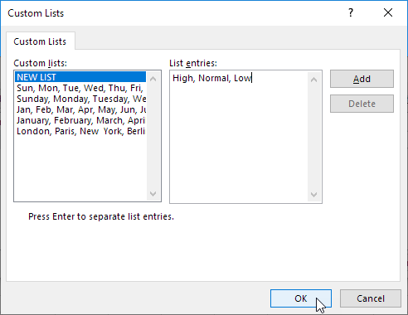
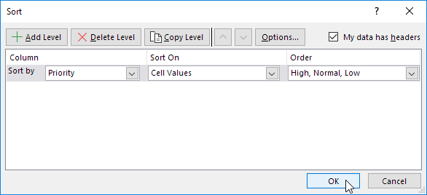
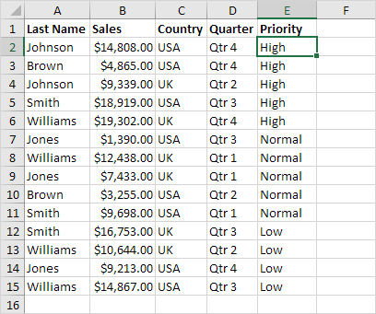
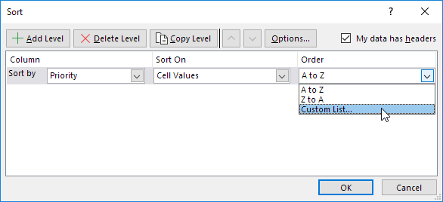
Sort on custom list (Sort by Priority (High, Normal, Low))
Basic Data Manipulation (Sorting)
Click any cell inside the data set.
On the Data tab, in the Sort & Filter group, click Sort.
Select Priority from the 'Sort by' drop-down list.
Select Custom List from the 'Order' drop-down list.
5. Type the list entries and click OK

Slide 10
References
Borle, S. Introduction to Data Analysis Using Excel [MOOC]. Coursera. https://www.coursera.org/learn/excel-data-analysis
https://support.microsoft.com/en-us/office/sort-data-using-a-custom-list-cba3d67a-c5cb-406f-9b14-a02205834d72

Slide 11
Questions?
Write your queries to
Soumalya.ghosh@galgotiasuniversity.edu.in​

Slide 12


